Slide 1


Gender Pay Gap Report
Snapshot March 31st 2025

Slide 2

Contents
Headings | Slide No
Executive Summary | 2 – 5
Introduction | 7
About NHS Frimley Integrated Care Board | 8
Scope of Agenda Pay Gap Report | 9
Workforce Profile | 10
Gender Pay Gap Disclosure – Key Findings | 11
Gender Pay Gap – Comparisons 2023, 2024, 2025 | 12
Gender Pay Gap Analysis by Agenda for Change Bands | 13
Gender Pay Gap – March 2024 Snapshot – comparisons with South East ICBs | 14
Gender Pay Gap – March 2024 South East Snapshot Pay Quartile | 15
Gender Pay Gap – Comparison with National Average | 16
Possible Key Drivers for the Gender Pay Gap | 17
Closing the Pay Gap Action Plan as NHS Frimley Transitions to Thames Valley ICB | 18 19
Appendices Action Plan Gender Pay Gap Calculations Explained Gender Pay Gap – Agenda for Change 2023, 2024 & 2025 Gender Pay Gap by Quartile Gender Pay Gap NHS Frimley Data Comparison 2023, 2024 & 2025 References | 20 - 24

Slide 3
Gender Pay Gap March 2025 – Executive Summary
Disclosure Metrics | NHS Frimley Results
1. Percentage of men and women in pay quarter or quartile – where Quartile 1 is the lowest pay quarter and 4 the highest | Female staff have the highest representation in Quartile 2 (79.82%) and the lowest representation in Quartile 4 (55.75%). There has been a decrease of female staff in Quartile 4 as of March 31st 2025 (55.75%) compared to March 31st 2024 (61.82%). Male staff have the highest representation at Quartile 4 (44.25%) and the lowest at Quartile 2 (20.18%).
2. Mean (average) gender pay gap for hourly pay | The mean (average) gender pay gap for hourly pay in 2025 is 21.9%. This means the average hourly pay for women is 21.9% less than men. The mean pay gap for 2025 is 0.1% lower than 2024.
3. Median Gender Pay Gap for hourly pay | The Median Gender Pay Gap for hourly pay is 26.2%. This means the hourly pay gap at the median or ‘middle’ of the salary bands is 26.2% less for women compared with men. The median pay gap for 2025 has increased by 1.04%.
4. Bonus Pay | No bonus payments were declared through ESR

Slide 4
Gender Pay Gap, March 31st, 2025 – Executive Summary
Overall % Mean Pay Gap : Female mean hourly pay is approx. 21.9% lower than male hourly pay
Mean Male Hourly Pay: £42.71
Mean Female Hourly Pay : £33.37
Difference: £9.34
Overall % Median Pay Gap: Female median hourly pay is approx. 26.2% lower than male hourly pay
Median Male Hourly Pay: £38.06
Median Female Hourly Pay: £28.09
Difference: £9.97
Chart 1: NHS Frimley Gender Profile 2025
Definitions of Mean Pay Gap and Median Pay Gap
The mean (average) pay gap is calculated by adding up all employees’ salaries and dividing by the number of employees, then comparing the average pay between two groups (e.g., men vs. women).
The median pay gap is based on the middle point of salaries in each group. That is, if you line up all employees’ pay from lowest to highest, the median is the salary in the middle. The gap is the difference between the medians of the two groups.
Chart 3: Gender Analysis by Pay Quartile (%)

Slide 5
Gender Pay Gap, March 31, 2025 – Executive Summary
Measure | Strengths | Weaknesses
Mean Pay Gap | Takes into account all salaries, including very high earners. Useful for understanding overall earnings inequality. | Can be skewed by extreme salaries (outliers). May exaggerate the gap if a few people earn much more than the rest.
Median Pay Gap | Represents the typical employee in each group. Less affected by extreme values or outliers. Often considered a fairer representation of pay differences. | Ignores the distribution of the rest of the salaries. May understate inequality if high earners are disproportionately from one group.
Understanding Pay Inequality Through Mean and Median Measures
High mean, low median - Inequality is concentrated at senior levels
High mean, high median - Inequality exists across the organisation
Low mean, low median -Pay distribution is broadly balance
Median worse than mean - Widespread inequality at lower/middle grades
Mean and Median Pay Gaps: Strategic Indicators of Fairness and Progression
The median pay gap provides insight into the pay experience of the typical employee. The mean pay gap highlights the distribution of seniority, influence, and higher-paid roles within the organisation. Considered together, these measures are essential for assessing fairness, progression, and structural inequality.

Slide 6
Gender Pay Gap – Executive Summary
Workforce Distribution by Pay Quartile
Female representation is highest in Quartile 2 (79.82%) and lowest in Quartile 4 (55.75%), the highest-paid quartile.
There has been a notable decline in female representation in Quartile 4, falling from 61.82% in March 2024 to 55.75% in March 2025.
Male representation is highest in Quartile 4 (44.25%), reinforcing that men are increasingly concentrated in the highest-paid roles.
Interpretation of the above
  The reduction of women in the highest pay quartile is a key driver of the gender pay gap.
  Although women remain the majority even at senior levels, the rate of change favours men, which puts upward pressure on the overall pay gap.
  Mean (average) Gender Gap
  The mean gender pay gap is 21.9% in 2025.
  This represents a small improvement of 0.1 percentage points compared with 2024.
  Interpretation of the above
    The marginal improvement suggests some stabilisation in average earnings
    The change is very small and indicates that structural issues remain, particularly related to the distribution of staff across pay bands rather than pay differences within the same roles.
    Median Gender Pay Gap
    The median gender pay gap is 26.2%, meaning women earn 26.2% less than men at the midpoint of the pay distribution.
    The median gap has increased by 1.04% since 2024.
    Interpretation of the above
      An increasing median gap suggests that differences are widening
      This often points to slower progression for women, or a higher concentration of men in higher-paid roles within comparable bands.

Slide 7
Executive Summary
.
      Conclusions
      Representation alone does not close the pay gap
        Despite women being the majority in all quartiles, significant pay gaps persist.
      Senior pay distribution is a growing risk
        The decline in female representation in the highest-paid quartile is a concern.
      Worsening median gap highlights structural issues
        The increase in the median pay gap suggests systemic challenges affecting the majority of women, not just a small number of senior roles.
      Progression and career pathways require focus
        Attention is needed on how women move through pay bands and into the highest-paid roles.

Slide 8
Introduction
Legal Context: The Equality Act 2010 (Gender Pay Gap Information) Regulations 2017 require public sector organisations employing 250 staff and over to publish their Gender Pay Gap Report by end of March annually, providing ‘snapshot data’ for 31 March of the previous year. This is part of our Public Sector Equality Duty.
This report has been prepared in accordance with guidance published by the Government Equalities Office and the ‘snapshot’ information includes staff holding an employment contract on 31 March 2025, based on our Employee Staff Records (ESR) and provides comparative information from the previous two years. This will be NHS Frimley’s last report – future pay gap data will be reported for Thames Valley ICB from April 2027.
Why is Gender Pay Gap reporting important? Gender pay gap reporting highlights differences in the average (mean or median) earnings of men and women - expressed as a percentage of men’s earnings. For example, women earn 15% less than men.
How does it help? It helps to understand equality gaps at the workplace, female and male participation at different levels and if talent is maximised and rewarded fairly and effectively. Gender Pay Gap reporting promotes accountability and transparency and informs actions to minimise equality gaps.
How is Gender Pay Gap different from Equal Pay: Equal pay deals with pay differences between men and women carrying out same jobs, similar jobs or work of equal value. Failure to ensure equal pay for roles of equal value between men and women is unlawful.
Gender Pay Gap reporting shows the average hourly pay differences between men and women and whether any one gender is disproportionately over-represented at a particular salary band. Individual component calculations (mean, median, bonus and by pay quarter) help identify what is causing the difference and inform action plans to minimise the gaps.

Slide 9
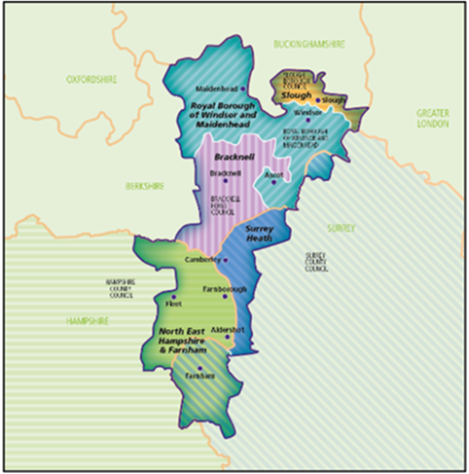
About NHS Frimley Integrated Care Board
NHS Frimley Integrated Care Board (NHS Frimley ICB) exists as a statutory organisation responsible for planning, arranging and meting the health and care needs of approximately 850,000 people living in the Frimley Integrated Care Service System. The system consists of five places defined as:
Bracknell Forest
Windsor & Maidenhead
Slough
Surrey Heath
North East Hampshire and Farnham
NHS Frimley ICB objectives:
Reduce Health Inequalities for all residents who experience unwarranted variation in their outcomes or experience
Increase Life Expectancy for the whole population, ensuring an improvement not just in length of life but in the quality of those years as well
NHS Frimley - Our plans and strategies

Slide 10
Scope of Gender Pay Gap Report
As part of Gender Pay Gap reporting requirements, the ICB is required to publish:
Percentage of men and women in each hourly pay quarter (or each quartile).
Mean (average) gender pay gap for hourly pay
Median gender pay gap for hourly pay
percentage of men and women receiving bonus pay
Mean (average) gender pay gap for bonus pay, and
Median gender pay gap for bonus pay.
Data collection is required for two types of employees:
‘relevant employees’ or those with an employment contract, including Bank staff.
‘full-pay relevant employees’ or those who are paid their usual full basic pay (including full-time, part-time staff and Bank staff).
We are expected to use data on :
‘relevant employees’ to calculate gender pay gap in bonus pay
‘full-pay relevant employees’ for all other gender pay gap calculations.
All pay information for this report has been drawn from Employee Staff Records (ESR) and is based on guidance, calculations and parameters applied across NHS reporting for Gender Pay Gap.
The following are not included in our calculations:
Agency workers and contractors employed by a service company (they are part of the headcount of that company).
Contractors offering a service rather than employment (for e.g. Non-Executive Directors).
Source: https://www.gov.uk/government/publications/gender-pay-gap-reporting-guidance-for-employers/who-needs-to-report#:~:text=Include%20self%2Demployed%20people%20in,own%20staff%20to%20do%20it.)

Slide 11
Workforce Profile, March 2025
NHS Frimley Gender Profile
NHS Frimley Workforce Gender Analysis AFC Pay Band
As of March 31st, 2025, NHS Frimley employed 441 staff, of which 71.88% were women and 28.11% were men.
Women were over-represented in all Agenda for Change (AfC) salary bands – with the proportion being highest at Band 3 (100%) and Band 6 (83%) and lowest at VSM (49% ).
The proportion of men was highest in Very Senior Manager (VSM) roles (51%) and Band 9 (42%). Compared with last year, the proportion at Band 9 decreased by 21%, while VSM increased by 5%. At Band 9, the number of male staff remained unchanged, while female staff numbers increased. In contrast, in the VSM category, female staff numbers declined, and male staff numbers increased (see Appendix XX).

Slide 12
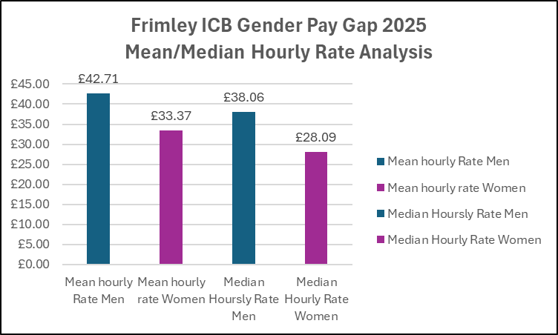
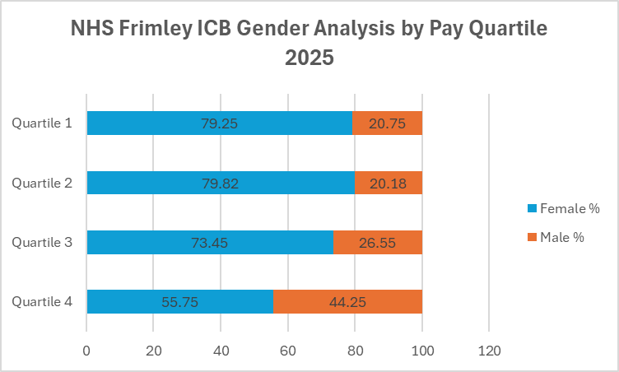
Gender Pay Gap Disclosure, March 31st, 2025
Mean Pay Gap: The mean pay gap was 21.9%, This means that in 2025, the average hourly rate for women was 21.9% less than men. When monetised, it means on average, for every £1 a men earned, women earned £0.78.
Median Pay Gap: The Median pay Gap was 26.2%. This means that in 2025 the median hourly rate was 26.2% lower than men. When monetised, this means for every £1 earned by men (in the median range), women earned 0.74p.
The mean hourly rate for women in 2025 was £9.34 less than men, the median hourly rate for women was £9.97 lower than men.
Pay Quartile: Females were over-represented in all four pay quartiles, with the highest representation being in Quartile 1 (79.25%) and the lowest in Quartile 4 55.75%). Male representation was lowest in Quartile1 (20.75%) and highest in Q4 (44.25%). See Chart 8a.
Bonus Pay: There was no bonus pay declared in 2024.
Frimley ICB | 2023 | 2024 | 2025
Mean Pay Gap | 20.5% | 22% | 21.9%
Median Pay Gap | 23.5% | 25% | 26.2%
Bonus Pay Gap | 0 | 0 | 0
Gender Pay Gap 2023 - 2025
Gender Pay Gap 2025 mean/median hourly rate analysis
Gender Pay Gap 2025 Mean/Median Hourly Rate Analysis

Slide 13
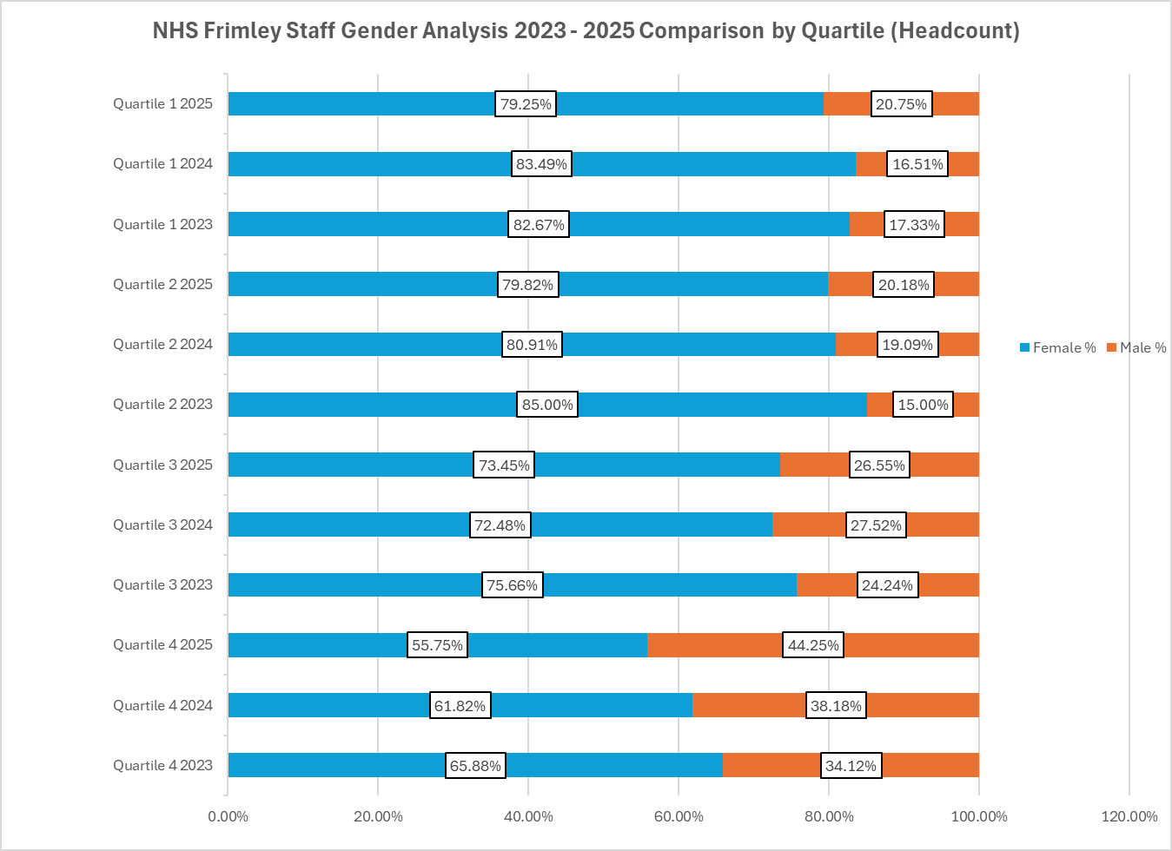
Gender Pay Gap 2023 - 2025
Mean and Median Hourly Pay Gap Comparison 2023 - 2025
Gender Analysis by Pay Quartile Comparison 2023 – 2025, 31st March 2025
The Gender Pay Gap results for 2025 highlighted:
The mean gender pay gap increased by 1.5% in 2024 and reduced marginally by 0.1% in 2025. The median pay gap has continued to widen since 2023, increasing by 1.2% compared with 2024.
Female representation in Quartile 4 declined by 6.07% in 2025 and has decreased by 10.13% since 2023. In contrast, male representation in Quartile 4 increased by 10.13% compared with 2024 and rose by 4.06% between 2023 and 2024 (see Appendix 2).
Quartile 3 recorded the largest increase in female representation in 2025, rising by 0.97% year on year. Female representation declined in Quartiles 1 and 2 by 3.42% and 5.18% respectively, reflecting increased male representation in these quartiles..

Slide 14
Gender Analysis by AfC Band – 2023 – 2025
The 3-year analysis of the gender analysis by pay band suggests:
Women are the majority across most AfC bands in all three years.
Female representation is trending down in several core bands from 2023→2025
Senior bands show mixed movement:
  Band 8C: a notable dip in the female share by 2025 (67% female).
  Band 8D: broadly stable but still majority female (71% female).
  Band 9: movement toward parity with men 2025 (58% female).
  Band 3 remains distinctly 100% female in 2024 and 2025, while Band 2 drops to zero
  incumbents by 2024/25. (See Appendix 1)
  Implication: The shift towards more men in several bands—especially Band 7 and Band 8C—suggests changing workforce composition that can influence both the mean and median pay gaps. Gains toward parity at Band 9 help, but the larger bands (with higher headcounts) will have greater impact on the overall gap.

Slide 15
Gender Pay Gap March 2024 Snapshot – Comparison with Southeast ICBs
Integrated Care Board | Mean Pay Gap % | Median Pay Gap % | Bonus Pay Gap %
Buckinghamshire Oxfordshire and Berkshire West | 21.4% | 12.7% | No bonuses were paid.
Surrey Heartlands | 9.7% | 12.3% | No bonuses were paid.
Kent and Medway | 27.1% | 15.1% | No bonuses were paid.
Sussex | 20.6% | 9.7% | No bonuses were paid.
Hampshire and Isle of Wight | 23.9% | 19.8% | No bonuses were paid.
Frimley | 20% | 25% | No bonuses were paid.
The above information is drawn from the Government Equalities Office website – it compares disclosure rates for the March 2024 snapshot for ICBs in the South East. ICBs with the highest Pay Gap are in Red, whilst those with the lowest Pay Gap are in Green.
Surrey Heartlands ICB had the lowest mean pay gap whilst Sussex ICB had the lowest median pay gap. Hampshire and Isle of Wight ICB had the highest mean pay gap and Frimley ICB had the highest median pay gap. The EDI Team are speaking to Sussex to understand their approach in this space.
March 2025 comparisons will be available from April 2026.

Slide 16
This Table highlights comparisons across pay quarters – focussing on the lowest pay quarter (Quartile 1) and highest pay quarter (Quartile 4). The ICBs with the lowest representation at Quartile 4 and highest representation at Quartile 1 are highlighted Red.
Gender Pay Gap March 2024 South East Snapshot – Pay Quartile
Integrated Care Board | Quartile 1 | Quartile 2 | Quartile 3 | Quartile 4 (highest paid)
Buckinghamshire Oxfordshire and Berkshire West | 90.7% | 77.8% | 71.8% | 67.5%
Surrey Heartlands | 83.9% | 82.2% | 80.3% | 72.7%
Kent and Medway | 88.2% | 81.6% | 74.4% | 61.5%
Sussex ICB | 83.2% | 85.8% | 75.8% | 65.7%
Hampshire and Isle of Wight | 88.0% | 83.1% | 74.3% | 64.3%
Frimley | 83.5% | 80.9% | 72.5% | 61.8%

Slide 17
Comparison with National Average in 2025
In April 2025, the Office for National Statistics (ONS) reported that the national median Gender Pay Gap was 6.9% (down from 7% in 2024). NHS Frimley ICB’s median Gender Pay Gap was as 26.2% at March 31 2025, which is 19.3% higher than the national average higher than the South East average across sectors of 11%.
Comparisons with peer ICBs in the South East will be undertaken in Q1 of 2026/27 after their Gender Pay Gap results are published.
Office of National Studies reported the following in April 2025:
Nationally, the gender pay gap has fallen by approximately a quarter among full-time employees over the last decade. It stood at 6.9% in April 2025, down from 7% in 2024.
The gap is larger for employees aged 40 years and over than those aged under 40 years. Women’s share in high paying jobs decreases with age.
The gap is larger among high earners than among lower-paid employees - with the highest gap found in skilled trades occupations and lowest in the caring, leisure and other service occupations.
Within England, the gap among full-time employees was higher in the South East (11%) and London (10.7%) – partly because these regions had more earning the highest wages.
The English regions had a higher pay gap compared with Wales (1.9%), Scotland (3.5%) and Northern Ireland (1.1%).
https://www.ons.gov.uk/employmentandlabourmarket/peopleinwork/earningsandworkinghours/bulletins/genderpaygapintheuk/2025#the-gender-pay-gap-by-region
Within the health sector, the Mend the Gap Report (2020) identified the following societal and structural factors contributing to the Gender Pay Gap among doctors:
Women being more likely to work less than full-time (LTFT), which lowers their pay.
Male doctors being more likely to be older, more experienced and hold more senior positions – which leads to higher pay.
Periods of LTFT working impact women’s career and pay trajectories negatively as they reduce their experience and slows down their progression to senior positions.
Among hospital doctors, gaps in total pay were largely due to Clinical Excellence Awards (CEAs), allowances and money from additional work – which are larger than gaps in basic pay alone.

Slide 18
Key Drivers of Gender Pay Gap
According to the Charted Institute of Personnel Development::
Gender pay gaps are often the outcome of economic, cultural, societal and educational factors.
Personal choices on working arrangements (part-time) and careers are often influenced by matters outside of the individual’s control, such as the availability and affordability of childcare – leading to structural barriers.
Choices available to women continue to be more constrained than those available to men.
Drivers of Gender Pay Gap
Unpaid caring responsibilities
Part-Time working
Differences in human capital
Occupational segregation
Undervaluing women’s work
Pay discrimination
https://www.cipd.org/uk/knowledge/guides/gender-pay-gap-reporting-guide/

Slide 19
Closing the Gap – Next Steps
Monitoring the Gender Pay Gap will be undertaken annually and we will continue to benchmark ourselves with peer comparators and learn from good practice across sectors to ensure we are closing pay and progression gaps and offering male and female staff equal opportunities to progress and be rewarded through robust, fair and objective methods.
Gathering data and developing our systems to monitor and report trends will be critical to that effort. The action plan will be monitored on an ongoing basis to support the ICB’s Equality Diversity and Inclusion Action Plan as it transitions into the new Thames Valley ICB. See Appendix 6 for the Gender Pay Gap Action Plan.
We will publish our ethnicity and disability pay gaps after the passage of the Equality (Race and Disability) Bill, which will make it a statutory duty to report both. We have started making preparations towards it and will report through our annual Public Sector Equality Duty Report.

Slide 20
Action Plan as NHS Frimley Transitions to Thames Valley ICB
The actions set out for 2025/26 under NHS Frimley (See Appendix 6) will be carried forward to inform and influence the development of the Thames Valley Integrated Care Board (ICB) approach to addressing the gender pay gap. These actions will provide a foundation for consistency, learning, and continuity during the transition to the new ICB arrangements and will be reviewed and adapted as required to reflect the governance, workforce profile, and strategic priorities of Thames Valley ICB.
The following ongoing governance and delivery arrangements will be considered as NHS Frimley transitions to the Thames Valley ICB
A Task and Finish Group will be established to oversee delivery of the gender pay gap action plan.
The group will report to the EDI Working Group, with upward reporting to the Executive Team and Board.
A detailed action plan will be developed, monitored, and reviewed through the EDI Team and OD Team.
Plan. Progress, risks, and impact will be reported regularly through agreed governance routes to ensure accountability and assurance.

Slide 21
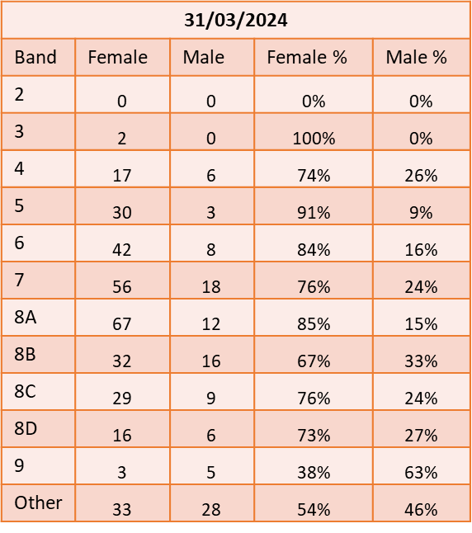

Appendix 3 – Gender by AfC Pay Grade
31/03/2023
Band | Female | Male | Female % | Male %
2 | 1 | 0 | 100% | 0%
3 | 2 | 1 | 67% | 33%
4 | 12 | 3 | 80% | 20%
5 | 26 | 5 | 84% | 16%
6 | 38 | 6 | 86% | 14%
7 | 48 | 13 | 79% | 21%
8A | 61 | 9 | 87% | 13%
8B | 26 | 10 | 72% | 28%
8C | 31 | 9 | 78% | 23%
8D | 14 | 7 | 67% | 33%
9 | 6 | 3 | 67% | 33%
Other | 29 | 22 | 57% | 43%
31/03/2025
Band | Female | Male | Female % | Male %
2 | 0 | 0 | 0% | 0%
3 | 3 | 0 | 100% | 0%
4 | 18 | 5 | 78% | 22%
5 | 29 | 8 | 78% | 22%
6 | 50 | 10 | 83% | 17%
7 | 55 | 19 | 74% | 26%
8A | 49 | 11 | 82% | 18%
8B | 41 | 18 | 69% | 31%
8C | 22 | 11 | 67% | 33%
8D | 12 | 5 | 71% | 29%
9 | 7 | 5 | 58% | 42%
Other | 31 | 32 | 49% | 51%

Slide 22
Appendix 4 – Gender Pay Gap by Quartile
The Proportion of men and women in each pay quartile (%) is calculated by ranking all employees from highest to lowest paid, dividing the workforce into four numerically equal parts (‘quartiles’) and working out the percentage of men and women in each of the four parts. (The lowest paid jobs are in quartile one).
31/03/2023
Quartile | Female | Male | Female % | Male %
4 Upper | 56 | 29 | 65.88 | 34.12
3 Upper middle | 75 | 24 | 75.76 | 24.24
2 Lower middle | 68 | 12 | 85.00 | 15.00
1 Lower | 62 | 13 | 82.67 | 17.33
31/03/2024
Quartile | Female | Male | Female % | Male %
4 Upper | 91 | 18 | 61.82 | 38.18
3 Upper middle | 89 | 21 | 72.48 | 27.52
2 Lower middle | 79 | 30 | 80.91 | 19.09
1 Lower | 68 | 42 | 83.49 | 16.51
31/03/2025
Quartile | Female | Male | Female % | Male %
4 Upper | 63 | 50 | 55.75 | 44.25
3 Upper middle | 83 | 30 | 73.45 | 26.55
2 Lower middle | 87 | 22 | 79.82 | 20.18
1 Lower | 84 | 22 | 79.25 | 20.75

Slide 23
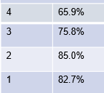
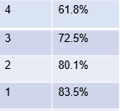
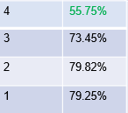
Appendix 5 – Gender Pay Gap Comparison NHS Frimley Data 2023, 2024 & 2025
31/03/23, 31/04/24 against 31/03/2025
Metric | 2023 | 2024 | 2025 | Notes
Headcount | 339 25% men (78) 75% women (261) | 438 25% men (111) 75% women (327) | 441 28.2% men (124) 71.88% women (317) | 2024 - Increased numbers due to intake of NHSE and SCW staff * ref slide 6 for details 2025 – slight increase in numbers due to growth
Median hourly rate | £34 per hour – men £26 per hour - women | £36 per hour – men £27 per hour - women | £38.06 – men £28.09 – women | At end March 2025 – women were earning 26.2% less than men. Men earn £1.35 for every £1.00 women earn
Mean hourly rate | £39 per hour – men £31 per hour – women | £41 per hour – men £32 per hour – women | £42.71 –men £33.37 - Women | As at 31/03/2025, men received a 4.17% increase and women received a 4.28% increase, which is a positive step toward bringing hourly rates closer to parity.
Quartiles (1 being lowest paid) Percentage of women |  |  |  | As at 31/03/23 women were over- represented in the lower pay quartiles (1st and 2nd) and men were over-represented in the 4th As at 31/03/24 the position had improved in the 2nd but declined in the others As at 31/04/25 has significantly improved in the highest quartile 4 and is over 50%. There has been some slight movement in the other quartiles.

Slide 24
Appendix 6 – Action Plan - NHS Frimley Gender Pay Gap
April – June Q1 | July – September Q2 | October – December Q3 | January – March Q4
Identify an Executive sponsor to lead on Gender Inequalities | Benchmark Gender Pay Gap findings against other ICBs (both nationally and locally) | Review intersectionality aspects (Ethnicity, Disability Pay Gaps) | Prepare for 2024/25 Pay gap report
Develop a Women’s Network across the ICB | Review national guides and action plans to incorporate best practice locally | Review ‘additional payments’ (on-call/ uplifts etc) to ascertain contribution to Gender Pay Gap | Ensure outcomes are included and reported in annual Equality report
Analysis of recent National Staff Survey to establish further Gender trends | Establish metrics and benchmarks for monitoring improvement |  | Ensure Inclusive recruitment practices are embedded and further upskill/ training for line managers
Engage broader staff networks (male, female, menopause, SPF etc) to further develop strategy | Review leaver rates and establish any trends, learning and best practice moving forward.

Slide 25
Appendix 6 - References
https://www.gov.uk/government/publications/gender-pay-gap-reporting-guidance-for-employers
https://www.closeyourpaygap.org.uk/pay-gap-guide/#rlslider_1
https://www.gov.uk/government/publications/gender-pay-gap-reporting-guidance-for-employers/making-your-calculations#:~:text=Take%20the%20mean%20(average)%20hourly,Multiply%20the%20result%20by%20100
https://www.ons.gov.uk/employmentandlabourmarket/peopleinwork/earningsandworkinghours/bulletins/genderpaygapintheuk/2025#the-gender-pay-gap-by-region
https://www.closethegap.org.uk/content/faq/#rlslider_10

